Slide 1
CS5112: Algorithms and Data Structures for Applications
Balanced search trees
Ramin Zabih
Some pictures from Wikipedia

Slide 2
Administrivia
Prelim (midterm) date: Wednesday October 16
Web site is: https://cornelltech.github.io/CS5112-F19/
Now has graders, tentative syllabus
Office hours are up, locations coming shortly
Quiz #2 will be out Thursday, due in 24 hours
We are looking into getting lectures recorded
Digression = fun material you are not responsible for

Slide 3
Lecture Outline
Digression: the web as a graph
Data structure invariants
Binary search trees
Asymptotic complexity and balancing
Red-black trees

Slide 4
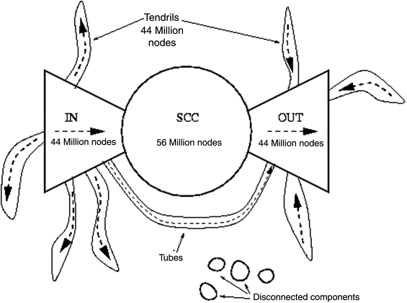
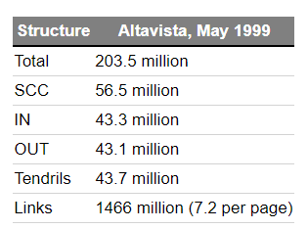
Digression: web as a graph
See: https://kharshit.github.io/blog/2017/09/08/structure-of-the-web

Slide 5
Data structure invariants and debugging
An invariant is a property of a program/data structure that must always hold for it to be correct
Good programmers check invariants frequently!
Tools like assert()
E.g., in sqrt(float x) you assert x >= 0
Optimized out in production code
Key to debugging is finding errors as early as possible
Kind of like a crime scene

Slide 6
assert() is your friend
See: Writing Solid Code (from Microsoft!)
Good discussion here of its importance
“How many times have you written the assumptions your function makes in a comment at the top of your code? How many times have you traced bugs down deep into the bowels of a codebase only to find that somebody (maybe you!) disregarded the assumptions outlined in the comment? If you … employ the use of assert statements to enforce the assumptions made in your code, you can rest assured that you’ll be notified if any of those assumptions are ever ignored again.”

Slide 7
Example data structure invariants
In the union find array, a node’s predecessor is itself iff it is the root of a tree
In a sorted linked list, each element is greater than its predecessor
Lots of other examples
See: https://fgiesen.wordpress.com/2010/09/27/data-structures-and-invariants/ for a detailed example in C

Slide 8
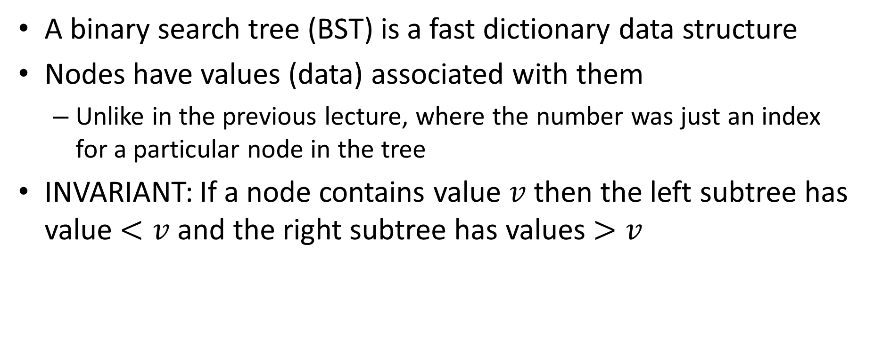
Binary search trees & their invariants
A binary search tree (BST) is a fast dictionary data structure
Nodes have values (data) associated with them
Unlike in the previous lecture, where the number was just an index for a particular node in the tree
INVARIANT: If a node contains value $v$ then the left subtree has value $<v$ and the right subtree has values $>v$

Slide 9
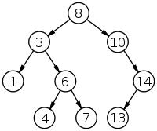
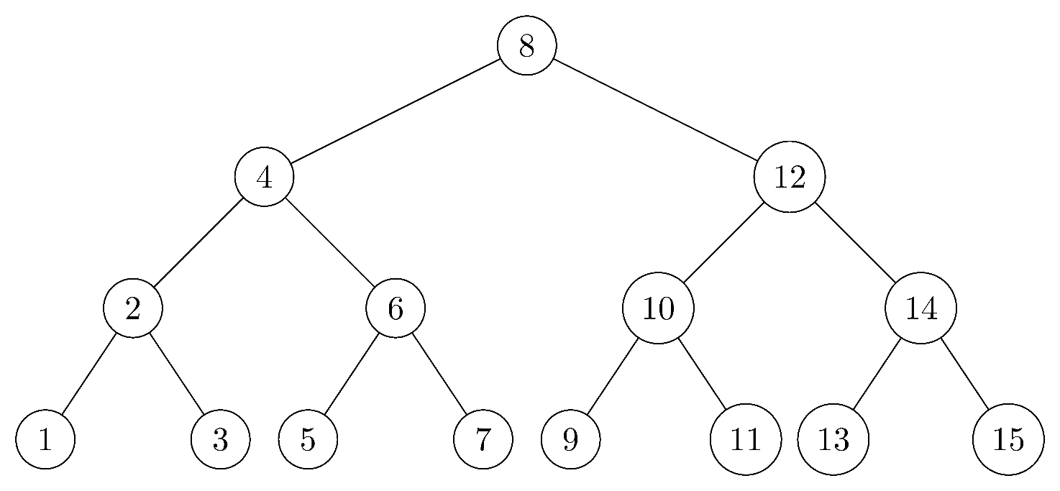
Binary tree examples
Complete binary tree of height 3

Slide 10
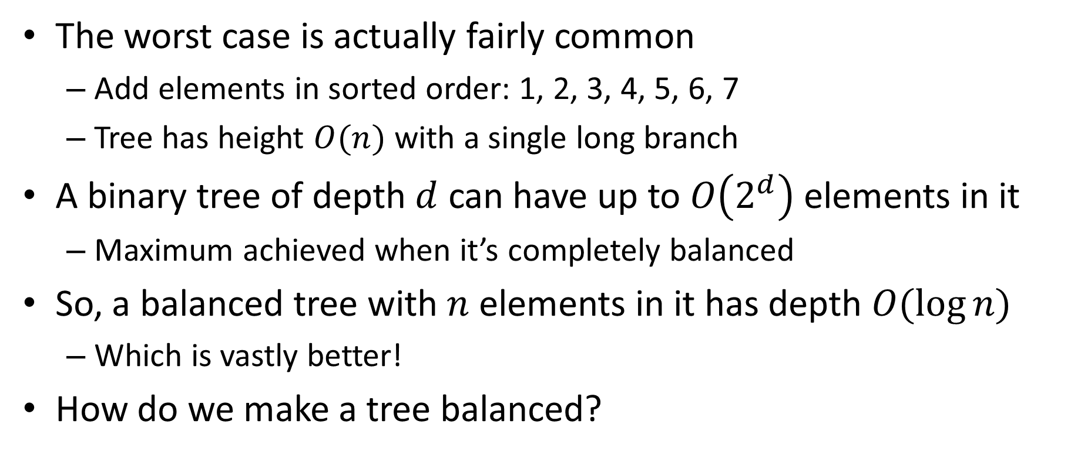
Running time
The worst case is actually fairly common
Add elements in sorted order: 1, 2, 3, 4, 5, 6, 7
Tree has height $O(n)$ with a single long branch
A binary tree of depth $d$ can have up to $O\left(2^{d}\right)$ elements in it
Maximum achieved when it’s completely balanced
So, a balanced tree with $n$ elements in it has depth $O(\log{n)}$
Which is vastly better!
How do we make a tree balanced?

Slide 11
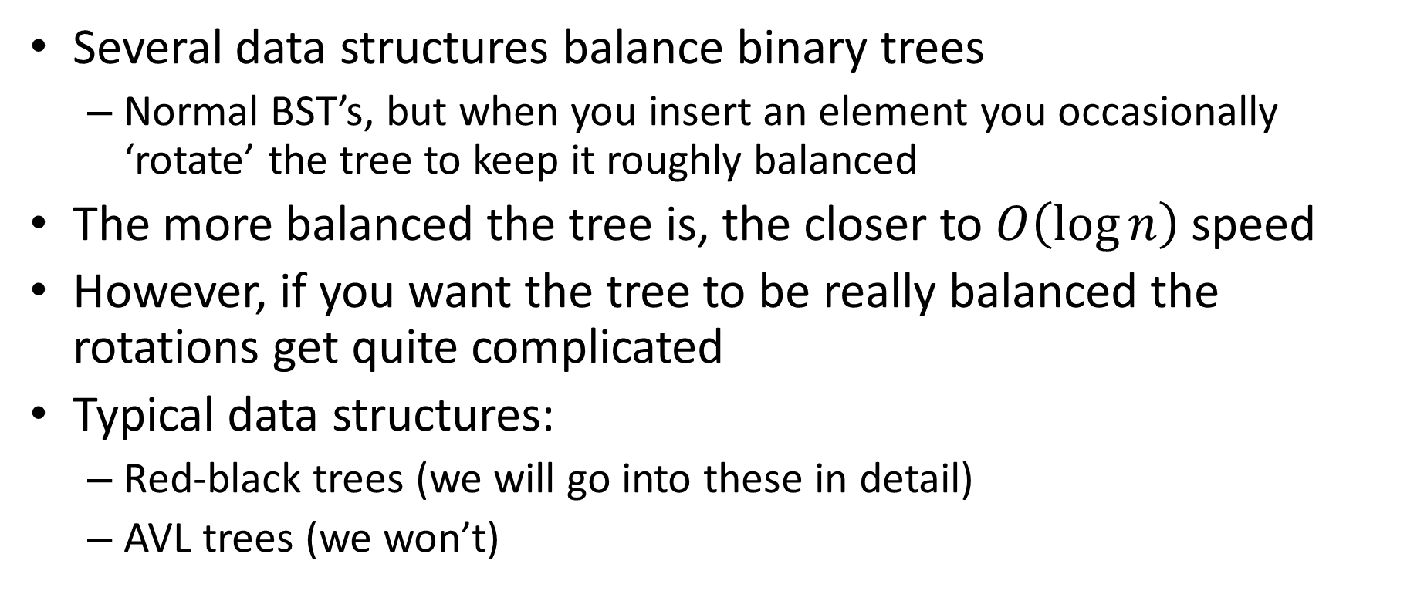
Self-balancing trees
Several data structures balance binary trees
Normal BST’s, but when you insert an element you occasionally ‘rotate’ the tree to keep it roughly balanced
The more balanced the tree is, the closer to $O\left(\log{n}\right)$ speed
However, if you want the tree to be really balanced the rotations get quite complicated
Typical data structures:
Red-black trees (we will go into these in detail)
AVL trees (we won’t)

Slide 12
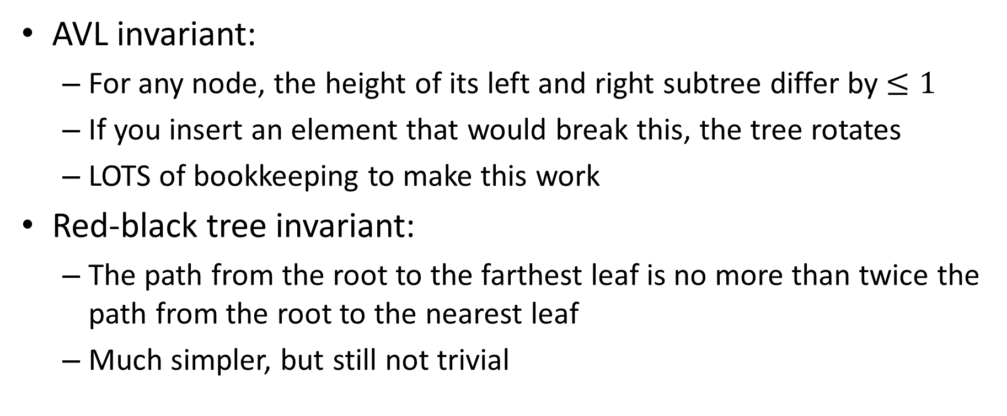
BST invariants
AVL invariant:
For any node, the height of its left and right subtree differ by $≤1$
If you insert an element that would break this, the tree rotates
LOTS of bookkeeping to make this work
Red-black tree invariant:
The path from the root to the farthest leaf is no more than twice the path from the root to the nearest leaf
Much simpler, but still not trivial

Slide 13
Red-black tree invariants
P1: Every node is either red or black
[Convention] Root is black
P2: There are no two adjacent red nodes along any path
P3: Every path from the root to a leaf has the same number of black nodes
This is the black height of the tree
If a tree satisfies these conditions so does every subtree
if not, the whole tree would not

Slide 14
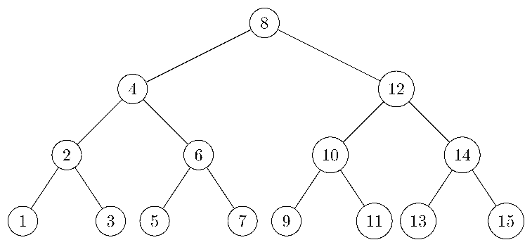
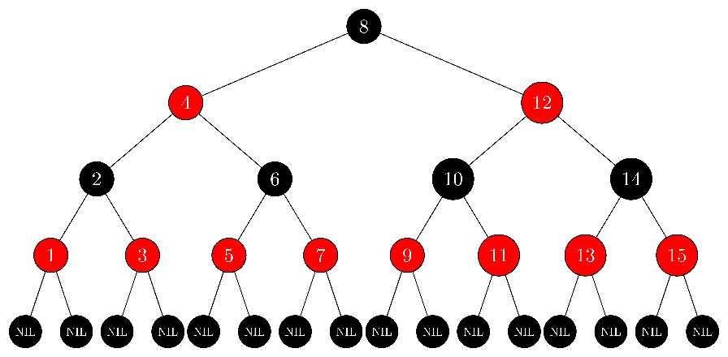
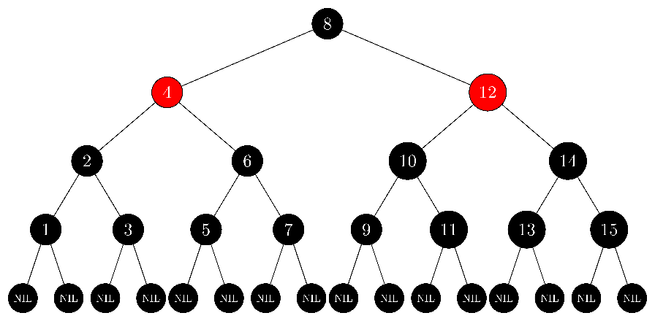
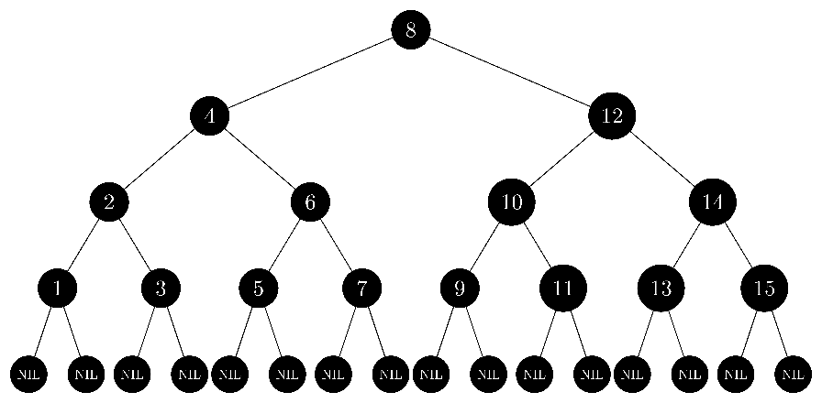
Black height = 2, 3, 4
Observation: red nodes are optional!

Slide 15
Red-black tree consequences
Subtlety: you can satisfy all of these invariants except P3 (= black height), and still have a wildly unbalanced tree
Just make it purely from black nodes!
With all these properties, the path from the root to the farthest leaf is no more than twice the path to the nearest. Proof?
P3: both paths have the same number of black nodes
P2: there are never two adjacent red nodes
So the longest path can at most insert a red node after each black one

Slide 16
Red-black tree operations
Lookup is easy
Just like a standard BST, ignore the node colors
What about insert?
In a standard BST we do a lookup, which shows where the new value should go
Example: insert in this tree:
Note that we can pick a new root
This is basically a rotation!

Slide 17
Red-black insert and rotations
We do the same thing but we color the node red to preserve P3 (black height of tree is unchanged)
But we have now broken P2 if the parent was red
So we need to patch up the tree by tree rotation
We must be able to increase black height (why?)
We not only need to consider the red parent
But also its parent (new node’s grandparent)
Which is black (why?)

Slide 18
There are four cases to consider
We can consider them all at once by symmetry
$$a<x<b<y<c<z<d$$
z
y
y
d
x
z
x
c
a
b
c
d
a
b

Slide 19
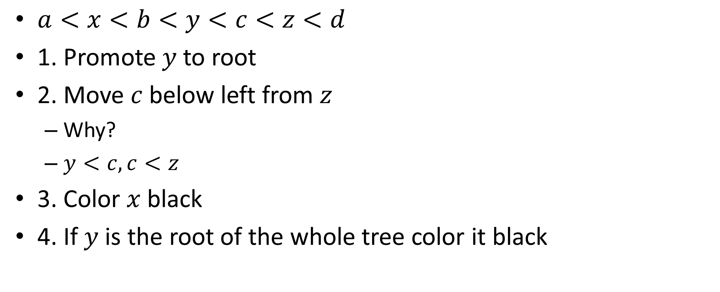
Why is this rotation valid?
$a<x<b<y<c<z<d$
1. Promote $y$ to root
2. Move $c$below left from $z$
Why?
$y<c, c<z$
3. Color $x$black
4. If $y$ is the root of the whole tree color it black
z
y
y
d
x
z
x
c
a
b
c
d
a
b

Slide 20
Red-black tree four symmetries
z
y
d
x
c
a
b

Slide 21

AVL trees are much more painful
Invariant is the balance factor at each node, height difference between left and right subtrees. Must be $\{0, ±1\}$

